Slide 1
CAPSTONE PROJECT
Final Project
Personal Development and Goal Tracking App
Presented By
GANESHWARI T
711721244015
III BTech CSBS
KGISL Institute of Technology
3/21/2024 Annual Rev iew

Slide 2
PROJECT TITLE
Personal Development and Goal Tracking App AI using Autoencoder.
3/21/2024 Annual Rev iew

Slide 3


AGENDA
Problem Statement
Project Overview
End Users
Solution and Value Proposition
The Wow Factor in Your Solution
Modelling
Results
3/21/2024 Annual Rev iew

Slide 4

PROBLEM STATEMENT
Personal Development and Goal Tracking App AI using Autoencoder
Gaps in Traditional Personal Development Tracking Methods
Evolving Needs of Modern Individuals
The Desire for Personalized and Intelligent Tracking Solutions

Slide 5

PROJECT OVERVIEW
Conceptualizing Personal Development in the Digital Age
Harnessing Technology for Holistic Growth
The Synergy of AI and Autoencoders in Goal Tracking

Slide 6

WHO ARE THE END USERS?
New Entrants to Personal Growth Journey
Career Shifters and Skill Upgraders
Educators and Trainers Focusing on Continuous Improvement
3/21/2024 Annual Rev iew
6

Slide 7

YOUR SOLUTION AND ITS VALUE PROPOSITION
Understanding Autoencoders: A Brief Introduction
Leveraging Autoencoders for Dynamic Goal Mapping
Augmenting Goal Setting with AI-driven Insights
Personalized Roadmaps for Success

Slide 8

THE WOW IN YOUR SOLUTION
Predictive Analysis for Future Goal Setting
Social Integration for Peer Support and Collaboration
Virtual Coaching with AI Assistance
Customizable Dashboards for Individual Preferences

Slide 9
MODELLING
Data Acquisition Strategies for Rich Insights
Fine-tuning Autoencoder Architecture for Efficiency
Balancing Compression with Information Retention
Setting Performance Benchmarks for Model Evaluation

Slide 10
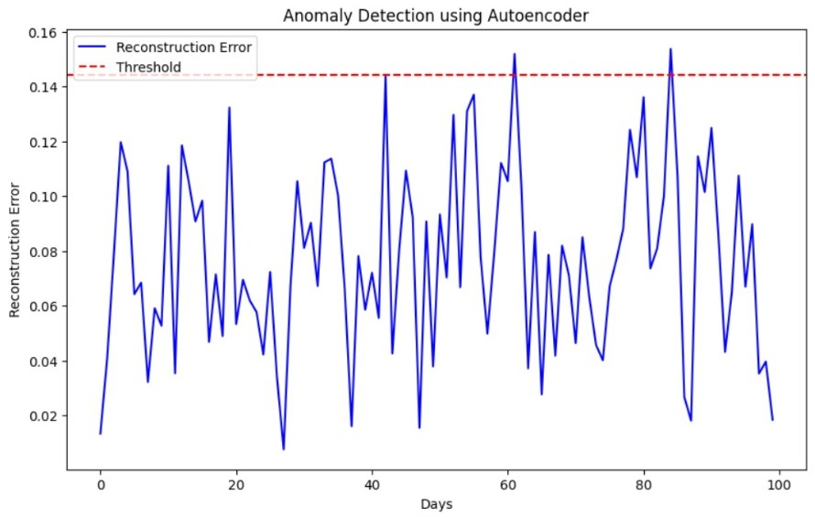
RESULTS
https://drive.google.com/drive/folders/1mj4seK-MFESjM3TYecQt3ufe0VjEgADz?usp=drive_link

